Slide 1
On the Quality of Neural Machine Translation of
Public Health Information in Hong Kong
(English-Chinese Translation)
SIU Sai Cheong (School of Translation, Hang Seng Management College)
SIU Sai Yan (School of Public Health, The University of Hong Kong)

Slide 2
Outline
Background
Public Health Information
Machine Translation of Public Health Information
New Possibilities Offered by Neural Machine Translation
Evaluation
Issues and Suggestions

Slide 3
Background
Timely and accurate translation of public health materials is of great importance
The use of automatic translation tools could be useful, especially after the rise of neural machine translation systems in recent years
However, there have been few studies of its application to the public health domain

Slide 4
This Project
Studying neural machine translation of public health materials in Hong Kong
Considering three online machine translation engines: Google Translate, Microsoft Translator and Sogou Translator

Slide 5
Public Health Information

Slide 6
Public Health Information
Public health departments play a pivotal role in disseminating accurate and comprehensible health promotion messages to the public (Regidor et al., 2007)
Public health information is available in different formats including pamphlets, posters, press releases, web pages, TV announcements, video clips and even mobile applications.

Slide 7
Sources of Public Health Information in Hong Kong
The Department of Health: Health education, surveillance and epidemiology
The Hospital Authority: Management of public hospitals
Private medical organizations and hospitals

Slide 8
Machine Translation of Public Health Information

Slide 9
Multilingual Public Health Materials
The production of quality cross-lingual public health materials could be costly and time-consuming.
The global public health research community has an increasing interest in automatic translation of public health information.

Slide 10
Relevant Research
Kirchhoff et al. (2011) investigated the feasibility of translating health promotion materials with a freely available statistical machine translation website. The study only analyzed the translations of documents from English to Spanish.
Turner et al. (2015) conducted follow-up research to examine the performance of Google Translate in translating English health promotion documents into Chinese. There were problems such as errors of word sense and word order.

Slide 11
Traditional Approaches to Machine Translation
01
I go to school by bus.
我／去／學校／乘／公車／。
我乘公車去學校。
Rule-based Machine Translation
02
I go to school by bus.
I go to school by taxi. 我乘計程車去學校。
我乘公車去學校。
Example-based Machine Translation
03
Translation Model
P(“I”|“我”) x P(“go”|“去”) x ...
Language Model:
P(“我乘公車去學校”)
Statistical Machine Translation

Slide 12
New Possibilities Offered by Neural Machine Translation

Slide 13
New Approach: Neural Machine Translation
Deep Learning: the use of multiple layers of artificial neurons
Automatic feature engineering: Converting the input into an internal representation that captures the features of the input by using deep neural networks
Areas of Application: Speech recognition, handwriting recognition, image processing, and machine translation

Slide 14
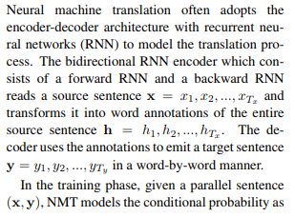
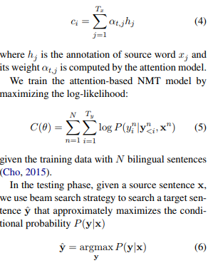
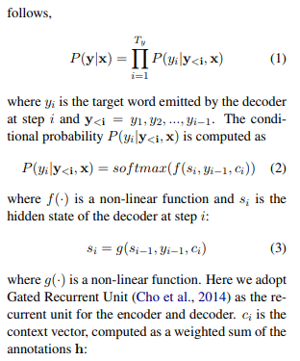
Neural Machine Translation
(http://aclweb.org/anthology/D17-1149)

Slide 15
Biological Neuron
dendrite
axon terminal
soma
2
activation
“input”
from
other
neurons
axon
“output” to
other
neurons
1
3
nucleus

Slide 16
Artificial Neuron
Input
1
Example: Adding (input value x weight)
Example: If the sum of the input > 0, the output = 1.
weight = 0.5
Output
0
weight = 0.2
Activation Function
1
Sum
(~soma)
(~axon)
weight = 0.3
Ans: 0.8
1
(~dendrites)

Slide 17
Artificial Neuron
0
1
0
1
A list of numbers
A number
1

Slide 18
Artificial Neural Network: Many Neurons
Input
Hidden
Output
Neuron
1
Neuron
2
1
1
0
0
1
1
1
0
0
1
0
1
…
…
…
Neuron n-1
Neuron
n

Slide 19
Artificial Neural Network
1
1
0
0
1
1
1
0
0
1
0
1
A number
A list of numbers
Another list of numbers
(more “meaningful”)
1

Slide 20
Artificial Neural Network
1
1
0
0
1
1
1
0
0
1
0
1
A number
A list of numbers
Another list of numbers
(more “meaningful”)
1

Slide 21
Artificial Neural Network and Image Processing
Probability
that the picture
is a …
0
1
0
1
0
1
1
0
0.55
0.300.10
0.05
cat
tiger
dog
man
Multi-class Classification

Slide 22
Neural Machine Translation
1 Data Collection
Bilingual documents are collected for the training of a neural machine translation system
3 Encoding
The source text was encoded and converted to a sequence of vectors, an internal representation of the text
2 Word Embedding
Each token in the source text is mapped on to a sequence of numbers
4 Decoding
The internal representation is decoded and the most probable tokens in the target language are identified

Slide 23
NMT as a Prediction Problem: Given X, what is the next word?
Given the following:
ST: I / go / to / school / by / bus / . /
TT: 我 / 乘
Which of the following is most likely to be the next word?
公車
火車
學校
咖啡
電腦
翻譯

Slide 24
Neural Machine Translation as Multi-class Classification
Probability
Of the next Chinese word
0
1
0
1
0
1
1
0
1
0
0
1
0
1
0
1
0
1
0
1
0
0.02
0.95
0.03
0
0
0
0
0
0
0
0
0
0
0
你
我
他
乘
走
跑
公車
計程車
火車
去
來
學校
公司
公園
Probability
that the picture
is a …
0
1
0
1
0
1
1
0
ST: I go to school by bus.
0.55
0.300.10
0.05
cat
tiger
dog
man

Slide 25
Neural Machine Translation
Probability
of the next Chinese word
0
0
1
0
1
0
0
0
1
0
0
1
0
1
0
1
0
1
0
1
0
0
1
0
1
0
1
1
0
1
0
0
1
0
1
0
1
0
1
0
1
0
0
1
0
0
0
0
0
0
0
0
0
0
0
0
0
0
0
0.96
0.03
0.01
0
0
0
0
0
0
0
0
你
我
他
乘
走
跑
公車
計程車
火車
去
來
學校
公司
公園
你
我
他
乘
走
跑
公車
計程車
火車
去
來
學校
公司
公園
0
1
0
1
0
1
1
0
ST: I go to school by bus.
TT:
我

Slide 26
Neural Machine Translation
Probability
of the next Chinese word
0
1
1
0
0
1
0
0
1
0
0
1
1
0
1
0
1
1
0
1
0
0
0
1
0
1
0
0
0
1
0
0
1
0
1
0
1
0
1
0
1
0
0
0
0
0.96
0.03
0.01
0
0
0
0
0
0
0
0
0
0
0
0
0
0
0.80
0.10
0.10
0
0
0
0
0
你
我
他
乘
走
跑
公車
計程車
火車
去
來
學校
公司
公園
你
我
他
乘
走
跑
公車
計程車
火車
去
來
學校
公司
公園
ST: I go to school by bus.
TT:
我乘

Slide 27
Neural Machine Translation
Probability
of the next Chinese word
0
1
1
1
1
1
1
1
1
1
0
1
0
1
1
0
0
1
1
1
0
0
0
1
0
1
0
0
0
1
0
0
1
0
1
0
1
0
1
0
1
0
0
0
0
0
0
0
0.80
0.10
0.10
0
0
0
0
0
0
0
0
0
0
0
0
0
0
0.75
0.25
0
0
0
你
我
他
乘
走
跑
公車
計程車
火車
去
來
學校
公司
公園
你
我
他
乘
走
跑
公車
計程車
火車
去
來
學校
公司
公園
ST: I go to school by bus.
TT:
我乘公車

Slide 28
Neural Machine Translation
Probability
of the next Chinese word
0
0
0
0
1
1
0
0
0
1
1
0
1
0
1
1
0
1
0
0
0
0
1
1
1
1
1
1
1
1
1
0
1
0
1
1
0
0
1
1
1
0
0
0
0
0
0
0
0
0
0
0.75
0.25
0
0
0
0
0
0
0
0
0
0
0
0
0
0
0.90
0.08
0.02
你
我
他
乘
走
跑
公車
計程車
火車
去
來
學校
公司
公園
你
我
他
乘
走
跑
公車
計程車
火車
去
來
學校
公司
公園
ST: I go to school by bus.
TT:
我乘公車去

Slide 29
Types of Neural Machine Translation
Encoder-decoder (Recurrent Neural Networks using Long-short Term Memory Cells or Gated Recurrent Units) with Attention (Bahdanau, Cho, & Bengio, 2014; Luong, Pham, & Manning, 2015; Wu et al., 2016)
Convolutional Neural Networks (Gehring et al., 2017)
Self-attentional Transformers (Vaswani et al., 2017)

Slide 30
Examples (since 2016)
Google Neural Machine Translation
Microsoft Translator: AI Chinese-English machine translation system (news translation) that can translate with the same accuracy as a human
Tencent: Conference Interpreting (Simultaneous transcription and translation)
Sogou: WMT 2017 News Translation Task (1st in Chinese-English Translation and 3rd in English-Chinese Translation)

Slide 31
Evaluation

Slide 32
Press Releases
Bilingual press releases published by the Department of Health (see http://www.dh.gov.hk/english/press/press.html and http://www.dh.gov.hk/tc_chi/press/press.html)
Topics covered: updates on cases of infectious diseases, food poisoning clusters, preventive measures against diseases, follow-up investigations in response to detection of virus, identification of problematic cosmetic, medical or pharmaceutical products or devices, and health promotion activities

Slide 33
Source Texts for Evaluation
English press releases published by the Department of Health between January and March 2018 (20 press releases; 9,472 tokens)
Topics covered: Middle East Respiratory Syndrome (MERS), dengue fever, oral health, food poisoning, slimming products, influenza B infection, precautions against cold weather, Legionnaires’ disease, undeclared Western drug ingredients in powder prescribed by a Chinese medicine practitioner, avian influenza, and acute gastroenteritis

Slide 34
Reference Translations for Comparison
The corresponding press releases in Chinese

Slide 35
Machine Translation Systems Evaluated
Google Translate: Supporting over 100 languages and offers text translation (neural machine translation for languages including Chinese), speech translation, image translation, and offline translation (Google, n.d.)
Microsoft Translator: Providing text translation for more than 60 languages (neural machine translation for 21 languages including Chinese), speech translation for 10 languages, and image translation (Microsoft Translator, 2017)

Slide 36
Machine Translation Systems Evaluated
Sogou Translator: The first commercial translation system that is fully based on neural machine translation in Mainland China and supports some 60 languages (Sogou, 2018b)

Slide 37
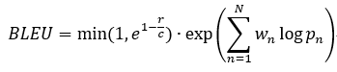
Automatic Evaluation
The use of Bilingual Evaluation Understudy (BLEU) metric (Papineni, Roukos, Ward, & Zhu, 2002), a measure of n-gram precision with a value between 0 and 1, comparing a machine translation output with a reference:

Slide 38
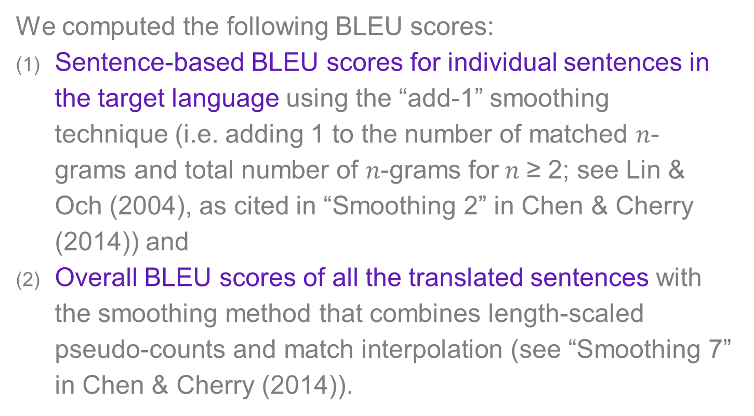
Automatic Evaluation
We computed the following BLEU scores:
Sentence-based BLEU scores for individual sentences in the target language using the “add-1” smoothing technique (i.e. adding 1 to the number of matched $n$-grams and total number of $n$-grams for$n$ ≥ 2; see Lin & Och (2004), as cited in “Smoothing 2” in Chen & Cherry (2014)) and
Overall BLEU scores of all the translated sentences with the smoothing method that combines length-scaled pseudo-counts and match interpolation (see “Smoothing 7” in Chen & Cherry (2014)).

Slide 39
Automatic Evaluation
Summary of sentence-based BLEU scores: Sogou Translator attained the highest average sentence-based BLEU score
 | Google | Microsoft | Sogou
1st Qu. | 0.0514 | 0.0426 | 0.0538
Median | 0.0729 | 0.0613 | 0.0800
Mean | 0.0879 | 0.0762 | 0.1008
3rd Qu. | 0.1150 | 0.0931 | 0.1261
Max | 0.3976 | 0.3593 | 0.4518

Slide 40
Automatic Evaluation
Distribution of sentence-based BLEU scores: Sogou had a higher percentage of sentences with a score greater than 0.30
Sentence BLEU | Google (%) | Microsoft (%) | Sogou (%)
<0.05 | 24.27 | 35.73 | 20.22
0.05≤x<0.10 | 44.27 | 42.7 | 44.27
0.10≤x<0.15 | 19.55 | 12.81 | 19.33
0.15≤x<0.20 | 7.87 | 4.04 | 6.97
0.20≤x<0.25 | 1.35 | 1.8 | 3.15
0.25≤x<0.30 | 1.35 | 2.02 | 2.92
0.30≤x<0.35 | 0.22 | 0 | 0.9
0.35≤x<0.40 | 1.12 | 0.9 | 1.8
0.40≤x<0.45 | 0 | 0 | 0
≥0.45 | 0 | 0 | 0.45
Overall BLEU scores: Sogou attained the highest overall BLEU score
 | Google | Microsoft | Sogou
Overall BLEU with smoothing | 0.2430 | 0.2319 | 0.2470

Slide 41
Human Evaluation
We conducted human evaluation by using 100 sentences randomly drawn from the dataset. We used the method of translation ranking (see, for example, Toral & Way (2018)), which has been a common way of conducting human assessment of automatic translation system in machine translation competitions in recent years.

Slide 42
Human Evaluation
Translation A

Translation B

- Preservation of information?
- Number of errors?
- Naturalness?
Rank1
Rank2
Translation
C
ST
OR
Translation B
VS
Translation A
Translation A

Translation B

Translation C

Rank1
Rank1
Rank2

Slide 43
Result of Human Ranking
Sogou Translator ranked first in terms of the proportion of translations given rank 1 (Google Translate and Microsoft Translator ranked second and third respectively). As for the aggregate proportion of translations given ranks 2 or 3, Microsoft Translator ranked first, followed by Google Translate and Sogou Translator.
 | Google (%) | Microsoft (%) | Sogou (%)
Rank 1 | 38 | 22 | 55
Rank 2 | 35 | 46 | 35
Rank 3 | 27 | 32 | 10
Total | 100 | 100 | 100

Slide 44
Translation Issues and Suggestions

Slide 45
Readable outputs
The three systems sometimes provided readable outputs with little post-processing, especially translations with a BLEU score equal to or higher than 0.25.
Source Text: Poultry should be cooked thoroughly.
Google Translate: 家禽應徹底煮熟。
Source Text: Investigations are ongoing.
Microsoft Translator: 目前正在進行調查。
Source Text: Read carefully the label instructions first;
Sogou Translator: 先仔細閱讀標籤說明；

Slide 46
Issue 1: Abbreviations
Source Text: Update on latest MERS situation in Oman
Reference: 阿曼中東呼吸綜合症最新情況
Google Translate: 更新阿曼最新的MERS情況
Microsoft Translator: 阿曼最新匯率情況(X)的最新情況
Sogou Translator: 阿曼市場匯率(X)最新情況

Slide 47
Issue 2: Proper nouns
Source Text: People who have purchased the products may submit them to the Drug Office of the DH at Room 1856, Wu Chung House, 213 Queen's Road East, Wan Chai, during office hours for disposal.
Reference: 已購買上述產品的市民可於辦公時間內將有關產品交予灣仔皇后大道東二一三號胡忠大廈一八五六室衞生署藥物辦公室銷毀。
Google Translate: 購買產品的人士可於辦公時間將其送交灣仔皇后大道東213號胡忠大廈1856室衛生署藥物辦事處(X)處理。
Microsoft Translator: 購買該等產品的人士, 可于辦公時間內, 在灣仔皇后大道東213號五湧樓(X)1856室向弶鍍 ' p 禁毒處(X)提交。
Sogou Translator: 市民如購買該等藥物，可于辦公時間內，將該等藥物交回灣仔皇后大道東213號胡忠大廈1856室衛生署毒品調查科(X)處理。

Slide 48
Issue 3: Word sense
Source Text: He attended the Accident and Emergency Department (AED) of Alice Ho Miu Ling Nethersole Hospital yesterday (March 7) and was admitted today.
Reference: 他於昨日（三月七日）前往雅麗氏何妙齡那打素醫院急症室求診，並於今日入院。
Google Translate: 他於昨日（三月七日）出席(X)雅麗氏何妙齡那打素醫院急症室，並於今日受理(X)。
Microsoft Translator: 他昨日 (3月7日) 出席(X)愛麗絲(X)何妙齡那打素醫院急症室 (AED), 並於今日入院。
Sogou Translator: 他昨日(三月七日)前往雅麗氏何妙齡那打素醫院急症室求診，並於今日入院。

Slide 49
Issue 4: Numbers
Source Text: According to the latest information, 2 144 cases have been reported to the WHO (with at least 750 deaths), including 1 927 in 10 Middle East countries comprising 1 769 in the Kingdom of Saudi Arabia, 86 in the United Arab Emirates, 28 in Jordan, 19 in Qatar, 11 in Oman, six in Iran, four in Kuwait, two in Lebanon, and one each in Yemen and Bahrain.
Reference: 根據最新資料，世衞至今獲通報2 144宗個案，至少750人死亡。當中10個中東國家確診共1927宗，其中沙特阿拉伯王國有1 769宗，阿拉伯聯合酋長國86宗，約旦28宗，卡塔爾19宗，阿曼11宗，伊朗六宗，科威特四宗，黎巴嫩兩宗，以及也門和巴林各一宗。
Google Translate: 根據最新資料，世衛組織報告了2 144例（至少750人死亡），其中包括10個中東國家的1 927例，其中沙特阿拉伯王國1 769例，阿拉伯聯合酋長國86例，阿拉伯聯合酋長國28例，約旦(X)，卡塔爾19人，阿曼11人，伊朗6人，科威特4人，黎巴嫩2人，也門和巴林各1人。
Microsoft Translator: 根據最新資料, 已向衛生組織報告了 2 144 起案件 (至少有750人死亡), 包括927個中東國家的 1 10 個(X), 沙烏地阿拉伯王國 1 769 個, 阿拉伯聯合大公國86個, 28 個在約旦, 19 個在卡塔爾。, 11 在阿曼, 六在伊朗(X), 四人在科威特, 兩個在黎巴嫩, 一個在葉門和巴林。
Sogou Translator : 根據最新資料，向世衛組織報告了2 144例病例(至少750人死亡)，其中10個中東國家1 927例，其中沙烏地阿拉伯王國1 769例，阿拉伯聯合大公國86例，約旦28例，卡塔爾19例，阿曼11例，伊朗6例，科威特4例，黎巴嫩2例 ，葉門和巴林各1例。

Slide 50
Issue 5: Sentence structure and word order
Source Text: The second case is a 6-year-old girl with good past health.
Reference: 第二宗個案涉及一名過往健康良好的六歲女童。
Google Translate: 第二種情況是一名身體健康的(X)6歲女孩。
Microsoft Translator:第二個案件是一個6歲的女孩與良好的過去健康(X)。
Sogou Translator: 第二個病例是一名6歲女孩，過去健康情況良好。

Slide 51
Issue 6: Punctuation marks
Source Text: Do not try to use salt, vinegar, wine and wasabi to kill bacteria as they are not effective; and (Department of Health, 2018o)
Reference: 不要嘗試使用鹽、醋、酒及日本芥末殺菌，因為均沒有殺菌效用；及(Department of Health, 2018p)
Google Translate: 不要嘗試用鹽，醋，酒和芥末(X)來殺死細菌，因為它們沒有效果;和
Microsoft Translator: 不要試圖使用鹽, 醋, 葡萄酒和芥末(X)殺死細菌, 因為它們是不有效的;和
Sogou Translator: 不要嘗試使用鹽、醋、酒和芥末來殺滅細菌，因為它們沒有效果；和

Slide 52
Issue 7: Omission or incomplete translation
Source Text: As of yesterday (March 8), 11 cases had been confirmed this year, all of which were imported cases. The cases were imported from the Philippines (five), Cambodia (two), India (one), Indonesia (one), Singapore (one) and Thailand (one).
Reference: 截至昨日（三月八日），今年共錄得11宗個案，均為外地傳入，分別從菲律賓（五宗）、柬埔寨（兩宗）、印度（一宗）、印尼（一宗）、新加坡（一宗）和泰國（一宗）傳入。
Google Translate: 截至昨日（3月8日），今年已確認11起，均為外來案件。 這些病例是從菲律賓（五），柬埔寨（二），印度（一），印度尼西亞（一），新加坡（一）和泰國（一）進口的(X)。
Microsoft Translator: 截至昨日 (3月8日), 今年已有11宗個案獲證實, 全部均為進口個案。案件從菲律賓 (五)、柬埔寨 (二)、印度 (一)、印尼 (一)、新加坡 (一) 和泰國 (一) 進口(X)。
Sogou Translator: 截至昨日(三月八日)，本年共證實十一宗個案，全部為外地傳入個案。 這些病例來自菲律賓( 5例)、柬埔寨( 2例)、印度( 1例)、印尼( 1例)、新加坡( 1例)和泰國( 1例)。

Slide 53
Issue 8: Problematic addition
Source Text: The CHP has also stepped up surveillance for possible human cases. Letters will be sent to doctors and hospitals today urging them to report any suspected cases.
Reference: 中心已就可能出現的人類感染個案加強監測，今日亦會發信予醫生及醫院呼籲他們呈報可疑個案。
Google Translate: 衛生防護中心也加強了對可能的人類病例的監測。信件將在今天發送給醫生和醫院，敦促他們報告任何疑似病例。
Microsoft Translator: 此外, 生防護中心亦加強監察可能發生的人類個案。警方(X)今日 (星期五)(X) 將信件送交醫生及醫院, 促請他們舉報懷疑個案。
Sogou Translator: 生防護中心亦加強監察可能出現的人類個案。 警方(X)今日會發信給醫生及醫院，促請他們舉報懷疑個案。

Slide 54
Issue 9: Wrong characters
Source Text: DH holds World Oral Health Day publicity event (with photo)
Reference: 衞生署舉辦世界口腔健康日推廣活動（附圖）
Google Translate: 衛生署舉行世界口腔健康日宣傳活動（附圖）
Microsoft Translator: 弶鍍 ' p (X)舉行世界口腔健康日宣傳活動 (帶照片)
Sogou Translator: 生署(X)舉辦世界口腔健康日宣傳活動(附圖)

Slide 55
Issue 10: Collocation
Source Text: They should seek medical advice and avoid school till 48 hours after the fever has subsided.
Reference: 他們應求診及避免上學，直至退燒後四十八小時。
Google Translate: 他們應該尋求醫療建議，並在發燒平息(X)後48小時內避免學校。
Microsoft Translator: 在發燒消退48小時後, 他們應該尋求醫療建議, 避免上學。
Sogou Translator: 他們應尋求醫療諮詢，避免上學，直到發燒消退後48小時。

Slide 56
Concluding Remarks

Slide 57
Application of NMT technology
Google Translate, Microsoft Translator and Sogou Translator were sometimes able to generate readable and publishable results
Sogou Translator tended to get higher scores in our automatic and manual tests
Common translation issues: pre-editing and post-editing

Slide 58
Future work
Expanding our testing datasets
Deriving pre-editing and post-editing guidelines
Considering other forms of public health information
Increasing the number of machine translation engines to be evaluated

Slide 59
Deep Learning Research and Application Centre
Hang Seng Management College

Slide 60
Deep Learning Research and Application Centre
Funding of HK$6.8 million (~US$890,000)
Hardware: Graphics processing unit (GPU)-accelerated hardware for much faster training and decoding
Software: PyTorch, Tensorflow, Keras, Transformer…
Projects involving deep neural networks

Slide 61
Projects
Machine translation (e.g., automatic translation of listing documents; recent funding: HK$1.4 million (~US$178,000))
Text mining, text summarization and information retrieval (e.g., clinical data or medical articles)
Classification and image analysis (e.g., more accurate classification of medical images for computer-aided medical diagnosis)
Prediction (e.g., epidemic outbreaks and stock prices)

Slide 62
References
Please refer to the proceedings.

Slide 63

Thank you
scsiu@hsmc.edu.hk
saicheong.com

Slide 64
More about Artificial Neural Networks
Neural networks and back-propagation explained in a simple way (https://medium.com/datathings/neural-networks-and-backpropagation-explained-in-a-simple-way-f540a3611f5e)

Slide 65
More about Artificial Neural Networks
Back-Propagation is very simple. Who made it Complicated? (https://medium.com/@14prakash/back-propagation-is-very-simple-who-made-it-complicated-97b794c97e5c)

Slide 66
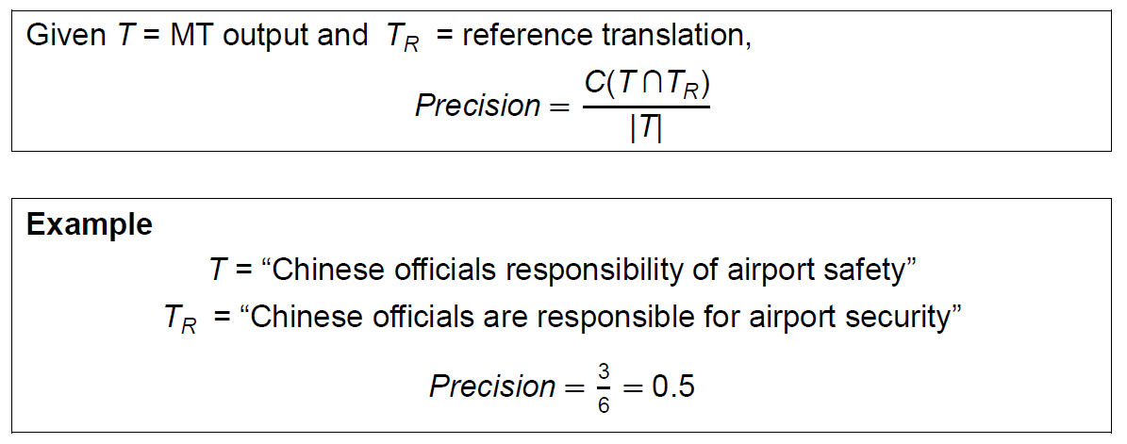
More about BLEU
For more information, visit
https://www.aclweb.org/anthology/P02-1040.pdf

Slide 67
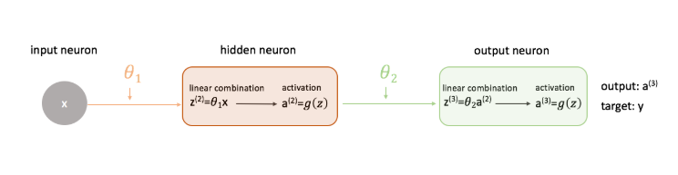
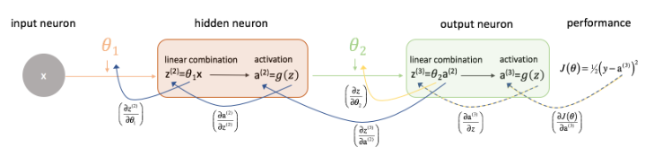
Training and Backpropagation
For more information, visit https://www.jeremyjordan.me/neural-networks-training/

Slide 68
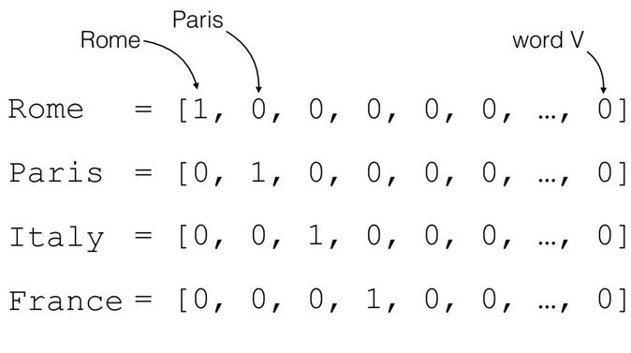
Word Embedding (1): One-hot Vector
For more information, visit
https://medium.com/@athif.shaffy/one-hot-encoding-of-text-b69124bef0a7

Slide 69
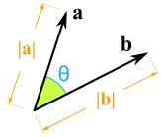
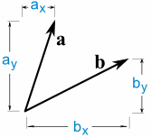
Problem
a · b = a_{x} × b_{x} + a_{y} × b_{y} = |a||b|cos(θ)
For more information, visit
https://www.mathsisfun.com/algebra/vectors-dot-product.html

Slide 70
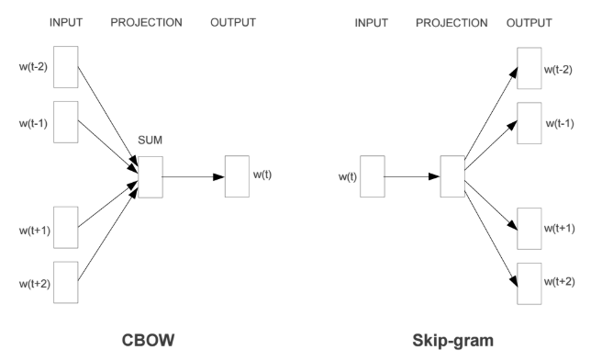
Word Embedding (2): Continuous Bag of Words and Skip-gram
For more information, visit
https://mubaris.com/2017/12/14/word2vec/

Slide 71
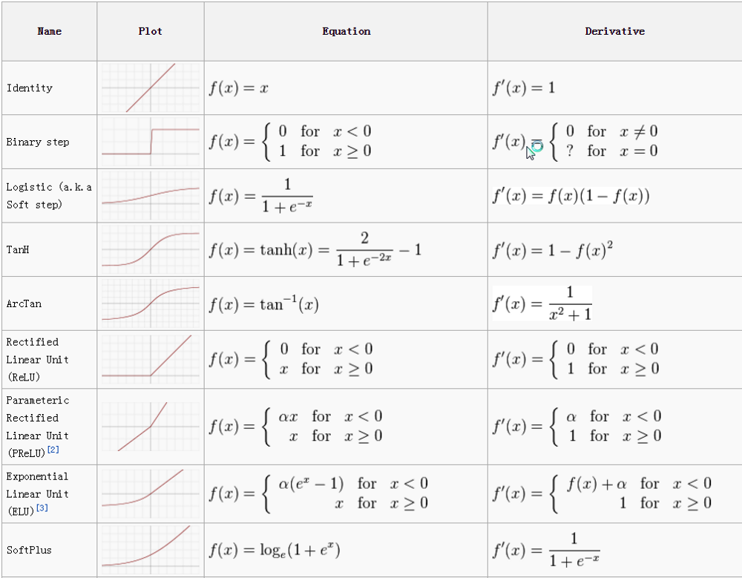
Activation functions
For more information, visit
https://towardsdatascience.com/activation-functions-neural-networks-1cbd9f8d91d6

Slide 72
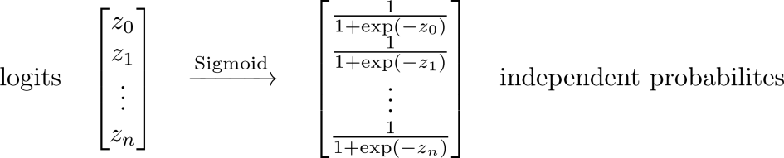
Softmax for Multi-class Classification (1)
The softmax function is a generalization of the logistic function that “squashes” a K-dimensional vector z of arbitrary real values to a K-dimensional vector of real values in the range [0, 1] that add up to 1.
[1.0,
2.0,
3.0,
4.0,
1.0]
[0.031062774127550943,
0.0844373744524495,
0.22952458061688552,
0.623912496675563,
0.031062774127550943]
For more information, visit
https://www.depends-on-the-definition.com/guide-to-multi-label-classification-with-neural-networks/

Slide 73
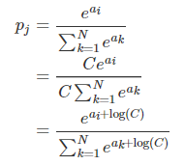
Softmax for Multi-class Classification (2)
Softmax function takes an N-dimensional vector of real numbers and transforms it into a vector of real number in range (0,1) which add up to 1.
For more information, visit
https://deepnotes.io/softmax-crossentropy

Slide 74
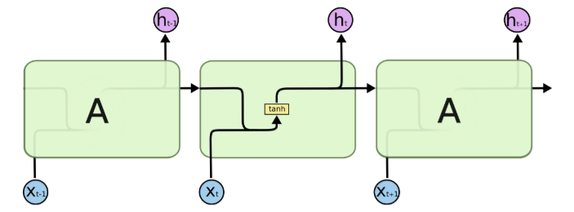
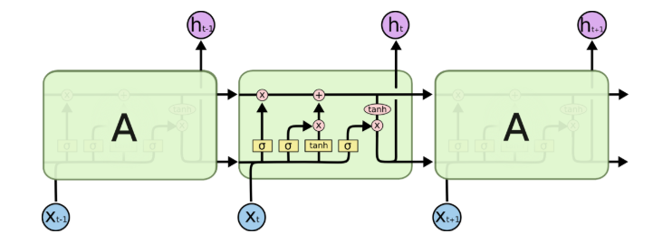
Standard RNN VS Long Short-term Memory
For more information, visit
http://colah.github.io/posts/2015-08-Understanding-LSTMs/

Slide 75
Attention Mechanism
Given [I] / [go] / [to] / [school] / [by] / [bus] / [.], what is the next word?
我
[I] / [go] / [to] / [school] / [by] / [bus] / [.] / [我] ⇒ ?
乘
[I] / [go] / [to] / [school] / [by] / [bus] / [.] / [我] / [乘] ⇒ ?
公車
[I] / [go] / [to] / [school] / [by] / [bus] / [.] / [我] / [乘] / [公車] ⇒ ?
去
[I] / [go] / [to] / [school] / [by] / [bus] / [.] / [我] / [乘] / [公車] / [去] ⇒ ?
學校
[I] / [go] / [to] / [school] / [by] / [bus] / [.] / [我] / [乘] / [公車] / [去] / [學校] / ⇒ ?
。
Translation: 我乘公車去學校。
Note: [ ] refers to internal representation

Slide 76
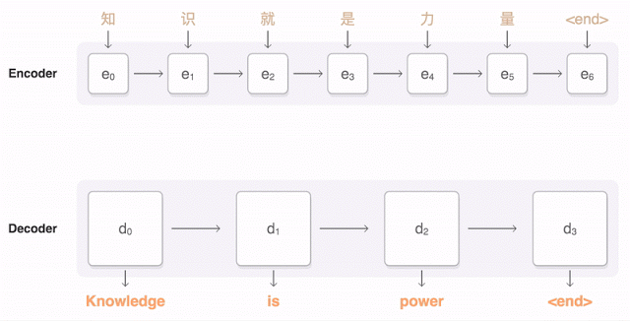
RNN Encoder-decoder with Attention
For more information, visit
https://ai.googleblog.com/2016/09/a-neural-network-for-machine.html

Slide 77
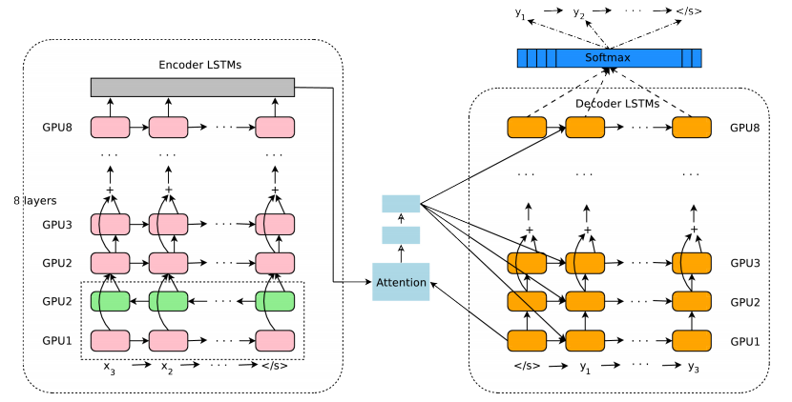
RNN Encoder-decoder with Attention
For more information, visit
https://arxiv.org/pdf/1609.08144.pdf

Slide 78
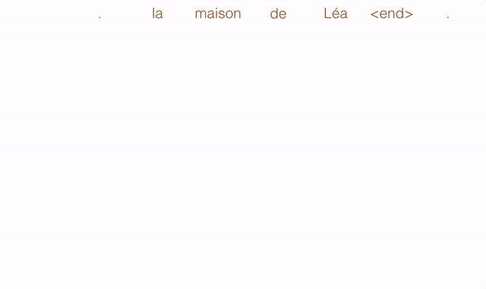
Convolutional NMT
For more information, visit
https://code.facebook.com/posts/1978007565818999/a-novel-approach-to-neural-machine-translation/

Slide 79
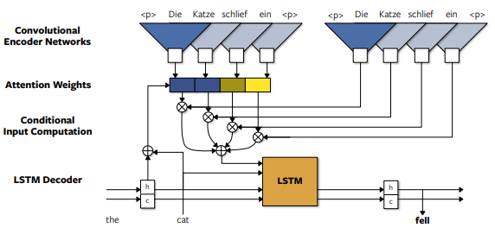
Convolutional NMT
For more information, visit
https://arxiv.org/pdf/1611.02344.pdf

Slide 80

Self-attentional Transformer
For more information, visit
https://ai.googleblog.com/2017/08/transformer-novel-neural-network.html

Slide 81
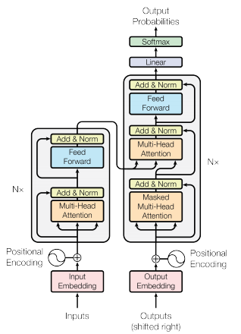
Self-attentional Transformer
For more information, visit
https://arxiv.org/pdf/1706.03762.pdf

Slide 82
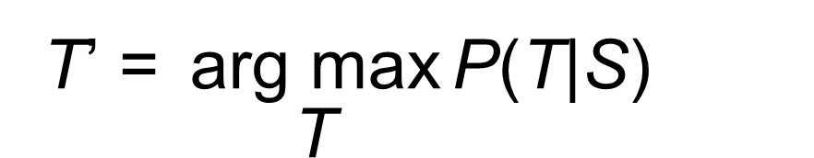
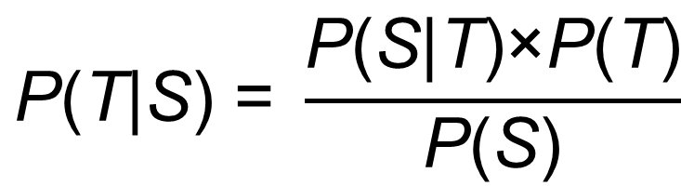
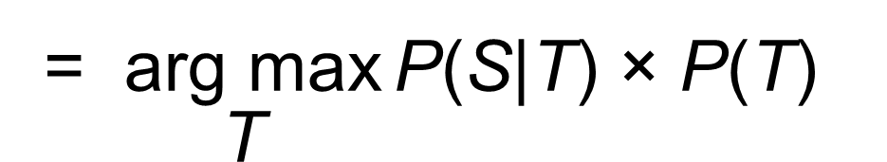
Statistical Machine Translation
$$\text{P}\text{(}\text{T}\text{|}\text{S}\text{) = }\frac{\text{P}\text{(}\text{S}\text{|}\text{T}\text{)×}\text{P}\text{(}\text{T}\text{)}}{\text{P}\text{(}\text{S}\text{)}}$$
T’ $\text{=} \underset{\text{T}}{\text{arg} \text{max}}{\text{P}\text{(}\text{T}\text{|}\text{S}\text{)}}$
= $\underset{\text{T}}{\text{arg} \text{max}}{\text{P}\text{(}\text{S}\text{|}\text{T}\text{) × }\text{P}\text{(}\text{T}\text{)}}$
Translation Model
Language
Model

Slide 83
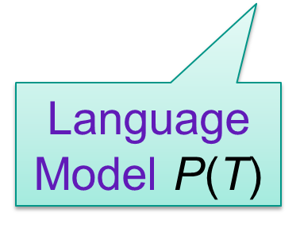
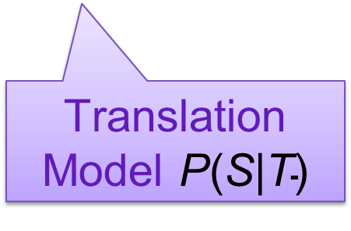
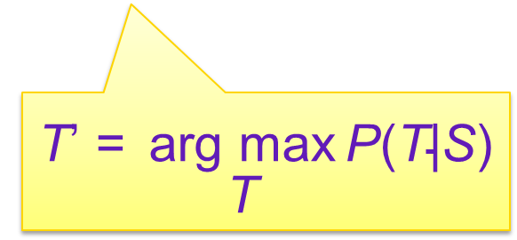
Statistical Machine Translation
Training
Decoding
Language
Model $\text{P}\text{(}\text{T}\text{)}$
Translation Model $\text{P}\text{(}\text{S}\text{|}\text{T}\text{)}$
T’ $\text{= }\underset{\text{T}}{\text{arg} \text{max}}{\text{P}\text{(}\text{T}\text{|}\text{S}\text{)}}$
Monolingual Corpus
Bilingual Corpus
Noisy-channel Model
Log-linear Model

Slide 84
Monolingual (in TL)
Bilingual
Data
Tables

Slide 85
Dogs love elephants.
Dogs elephants love.
Love dogs elephants.
Love elephants dogs.
Elephants love dogs.
Elephants dogs love.
Dogs loves elephants.
Dogs elephants loves.
Loves dogs elephants.
Loves elephants dogs.
Elephants loves dogs.
Elephants dogs loves.
User’s Input
MT Output
狗喜歡大象。
Dogs love elephants.
Bilingual Table
Monolingual Table

Slide 86
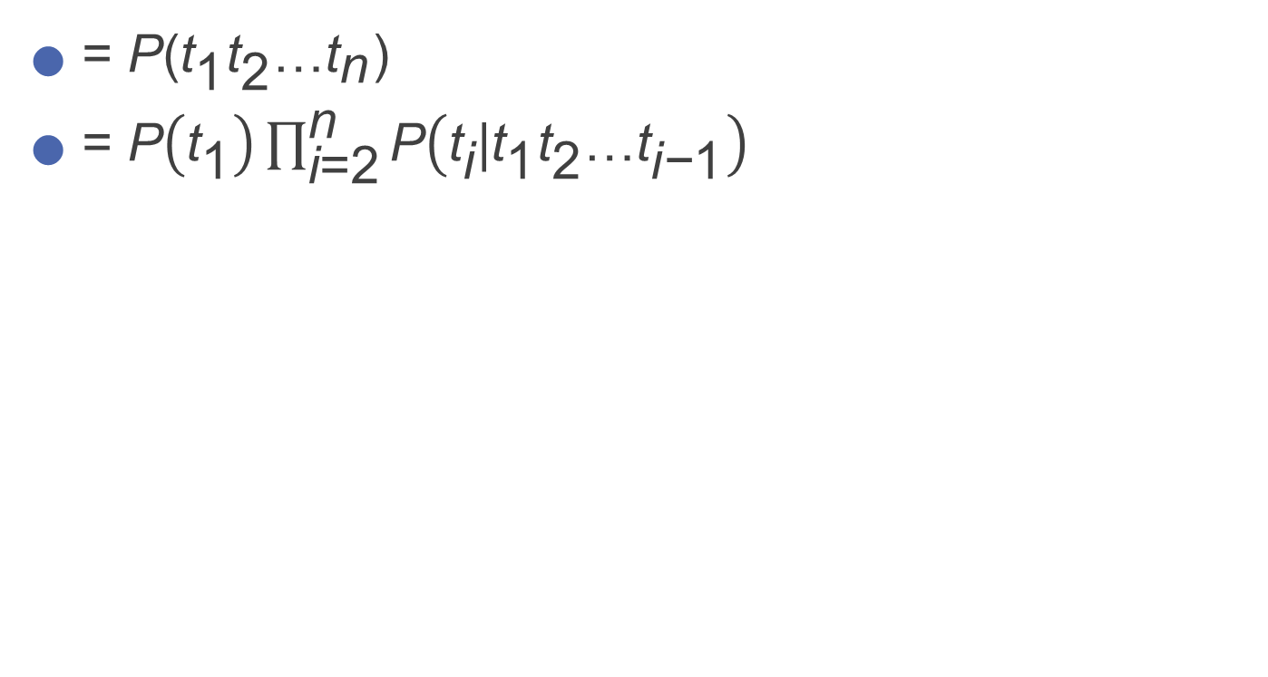
P(T)
= P(${\text{t}}_{\text{1}}{\text{t}}_{\text{2}}\text{…}{\text{t}}_{\text{n}}$)
= $\text{P}\left({\text{t}}_{\text{1}}\right)\prod_{\text{i}\text{=2}}^{\text{n}}{\text{P}\left({\text{t}}_{\text{i}}\text{|}{\text{t}}_{\text{1}}{\text{t}}_{\text{2}}\text{…}{\text{t}}_{\text{i}\text{−}\text{1}}\right)}$

Slide 87
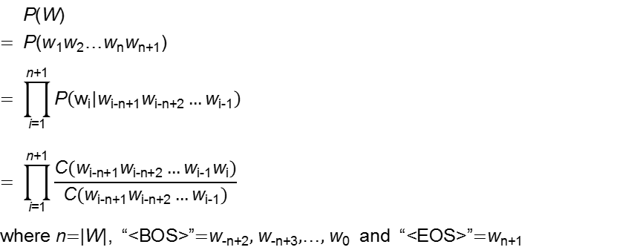
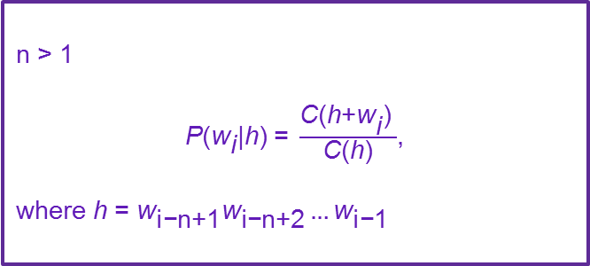

N-gram Model
We consider n words at a time (i.e., the word w and n-1 words in the context history h).
n = 1
$$\text{P}\text{(}{\text{w}}_{\text{i}}\text{) =} \frac{\text{C}\text{(}{\text{w}}_{\text{i}}\text{)}}{\text{|}\text{corpus}\text{|}}$$
n > 1
$\text{P}\text{(}{\text{w}}_{\text{i}}\text{|}\text{h}\text{) =} \frac{\text{C}\text{(}\text{h}\text{+}{\text{w}}_{\text{i}}\text{)} }{\text{C}\text{(}\text{h}\text{)}}$,
where h = ${\text{w}}_{\text{i}\text{−}\text{n}\text{+1}}{\text{w}}_{\text{i}\text{−}\text{n}\text{+2}}…{\text{w}}_{\text{i}\text{−}\text{1}}$

Slide 88
Unigram Model (n=1)

Slide 89
Bigram Model (n=2)

Slide 90
Trigram Model (n=3)

